Slide 1
55 Funny Facts about Level Design
by Jarek Francik
CI7870 Game Design

Slide 2

Meanings of the “Level”
4
environment or location
breaking up physical space
unit of progression
player rank based on score/skills/experience (RPG games)
Game designers have extremely limited vocabulary

Slide 3
Other Words for the “Level”
7
Rounds
Waves
Stage
Act
Chapter
Map
World

Slide 4
Steps of Story-Driven Level Design
4
World
Level
Experience
Moment to moment gameplay (Big Moments & Small Moments)

Slide 5
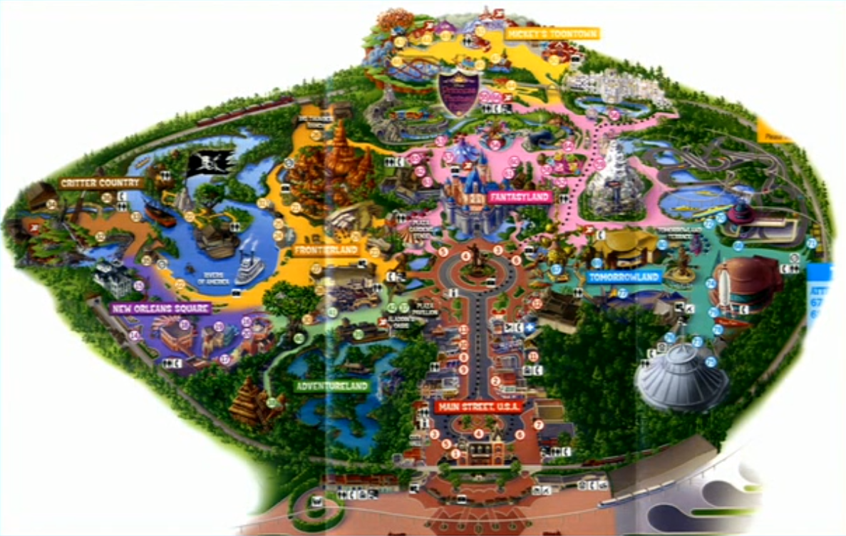

Slide 6
Clichés of Game Level Themes:
10
Outer Space
Fire/ice
Dungeon/cavern/tomb
Factory
Jungle

Slide 7
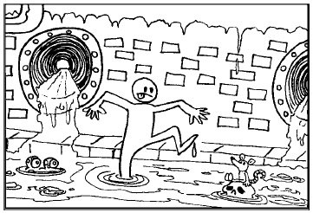
Clichés of Game Level Themes:
10
Outer Space
Fire/ice
Dungeon/cavern/tomb
Factory
Jungle
Haunted house or graveyard
Pirate ship/town/island
Gritty urban
Space station
Sewer

Slide 8
Clichés of Game Level Themes:
10
Outer Space
Fire/ice
Dungeon/cavern/tomb
Factory
Jungle
Haunted house or graveyard
Pirate ship/town/island
Gritty urban
Space station
Sewer
even a cliché can be made compelling
try to mix and match (Mexican Pizza paradigm)

Slide 9
Easy Ways to Create the Atmosphere
7
Lighting
Colour palette
Weather and atmospheric effects
Special visual effects
Music
Ambient audio
Special audio effects

Slide 10
Types of Level Maps
2
Alley (linear or parallel)
Island (network, open or hub-and-spoke)

Slide 13
Golden Rules of Map Design
3x3
Use environment to tell the story
Encourage player’s movement
Be an active designer, not a lazy designer

Slide 14
Golden Rules of Map Design
3x3
Use environment to tell the story
Theme world objects
Illusional narrative
Training by doing
Encourage player’s movement
Be an active designer, not a lazy designer

Slide 15
Golden Rules of Map Design
3x3
Use environment to tell the story
Encourage player’s movement
Be an active designer, not a lazy designer

Slide 16
Golden Rules of Map Design
3x3
Use environment to tell the story
Encourage player’s movement
Level maps and posters to give information and build anticipation
Weenies, fingers and rewards
Geometry, lighting and squint test
Be an active designer, not a lazy designer

Slide 17

Golden Rules of Map Design
3x3
Use environment to tell the story
Encourage player’s movement
Level maps and posters to give information and build anticipation
Weenies, fingers and rewards
Geometry, lighting and squint test
Be an active designer, not a lazy designer

Slide 18
Golden Rules of Map Design
3x3
Use environment to tell the story
Encourage player’s movement
Level maps and posters to give information and build anticipation
Weenies, fingers and rewards
Geometry, lighting and squint test
Be an active designer, not a lazy designer

Slide 19
Golden Rules of Map Design
3x3
Use environment to tell the story
Encourage player’s movement
Level maps and posters to give information and build anticipation
Weenies, fingers and rewards
Geometry, lighting and squint test
Be an active designer, not a lazy designer

Slide 20
Golden Rules of Map Design
3x3
Use environment to tell the story
Encourage player’s movement
Be an active designer, not a lazy designer

Slide 21
Golden Rules of Map Design
3x3
Use environment to tell the story
Encourage player’s movement
Be an active designer, not a lazy designer
Activity driven design
Pacing, progression and the grey box
Providing variety

Slide 22
Golden Rules of Map Design
3x3
Use environment to tell the story
Encourage player’s movement
Be an active designer, not a lazy designer

Slide 23
Pillars of the Beat Chart
12
Level Name
Location
Gameplay
Objective
Bonus material
Story beat
New weapon
Enemies
Mechanics
NPC
Time of day
Colour mapping

Slide 24
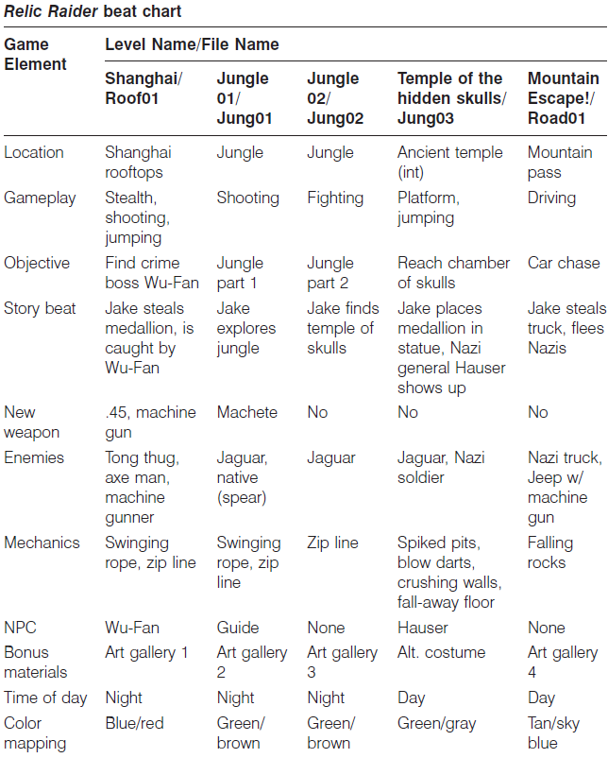

Slide 25
Conclusion (uncounted)
∞
Level Design is the art of assigning the Game Story to the Game Space
Always use top-down approach: start from the world and story, then to the level, experience, moment-to-moment gameplay.
Use environment to tell the story
Provide each level with the meaningful theme
Clichés are ok if you use them wisely
Always care about pace and progression, provide variety
Use Beat Chart to ensure game experience is properly distributed across all your levels

Slide 26
Sources
Scott Rogers: Level Up
Scott Rogers: Everything I Learned About Level Design I Learned from Disneyland, GDC Vault talk, http://www.gdcvault.com/play/1305/Everything-I-Learned-About-Level
Ernest Adams, Andrew Rollings: Fundamentals of Game Design

